Slide 1
Apollo
https://www.youtube.com/watch?v=hAqB9MjMmms&ab_channel=MekatNorray

Slide 2
Names and Roles
Group Leader - Ryan Saweczko
Report/Presentation: Concurrency, Abstract, Limitations
Presenter 1 - Briggs Fisher
Report: Introduction
Presentation: Introduction, Subsystems
Presenter 2 - Itay Ben Shabat
Report/Presentation: Sequence Diagrams
Tom Lin
Report/Presentation: Developer Responsibilities and Data Flow
Douglas Chafee
Report/Presentation: System Evolution, Conclusion
Karl Dorogy
Report: Subsystems, Derivation Process
Presentation: Derivation Process
Conceptual Architecture - Ryan, Karl, Tom

Slide 3

Introduction
This report is an analysis of the Apollo autonomous driving open software’s conceptual architecture. We will discover how Apollo competes in the ever expanding autonomous driving market through an analysis of their high level architecture.
The report is split into seven sections including the Derivation Process, Conceptual Architecture (and its eleven subsystems), System Evolution, Developer Responsibilities and Data Flow, Concurrency, Sequence Diagrams, and a batch of the limitations, conclusions, and lessons we learned.
The report will ultimately define Apollo’s high level architecture as implicit invocation with insights on Layered, Pipe and Filter, and Repository styles found within the submodules.

Slide 4
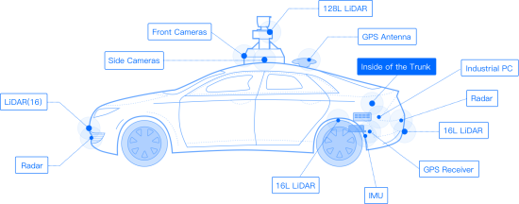

Derivation Process
In documenting and formulating Apollo’s conceptual architecture, the derivation process had three major steps, the first being:
Background Knowledge & Understanding
Each group member was assigned to read through "A functional reference architecture for autonomous driving" (Behere et al.)
Individually research through the documentation of Apollo (GitHub & Apollo Website)
Drafting a preliminary version of the conceptual architecture based on their understanding of the information they had read in addition to the provided lecture material within CISC 322/326.
Notes:
Feel free to edit to format ur presentation style ~karl

Slide 5

Derivation Process
In documenting and formulating Apollo’s conceptual architecture, the derivation process had three major steps, the second being:
Initial Group Meeting & Discussion
Once each member had developed a possible conceptual architecture type, a group meeting was set and held.
The entire group as a whole discussed the possible alternative architectures that each group member found and or created as well as their respective non-functional pros, cons, and invariants in regards to an autonomous driving software system.
After a long discussion we picked which modules/components should be included and excluded from the conceptual architecture as well as its overall type of being implicit invocation.
Ended the meeting by dividing up all the major points we wanted our documentation to cover and each group members' respective designated tasks that individuals were responsible for.
Alternative Architectures
Layered
Pipe and Filter
Implicit Invocation
Repository Style
Notes:
Feel free to edit to format ur presentation style ~karl

Slide 6
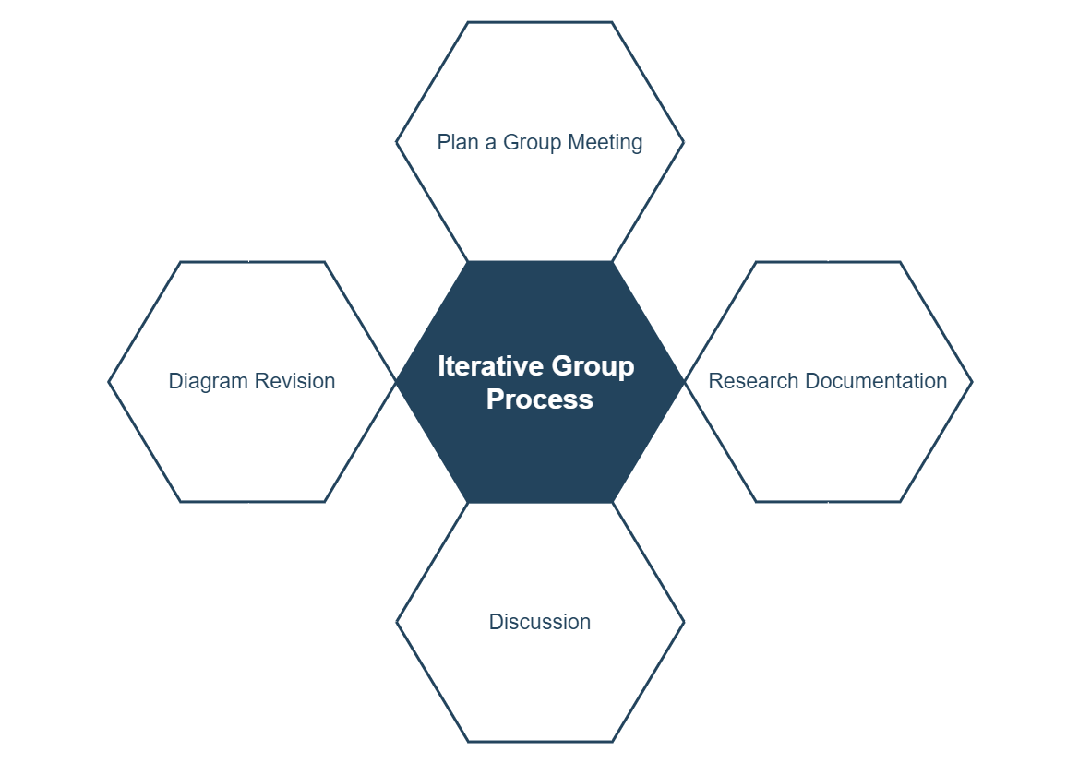
Derivation Process
In documenting and formulating Apollo’s conceptual architecture, the derivation process had three major steps, the third & final being:
Iterative Group Meeting & Finalization
After individuals have done some work on the documentation of their tasks and upon new understandings/findings within the documentation for apollo’s open-source platform for autonomous driving cars, additional meetings are set and held weekly.
Our group iteratively improved on our initial conceptual architecture and sequence diagram user cases, adding additional modules such as routing and audio in addition to discussing their involvement within the system and possible new dependencies that have arisen between components.
Ultimitally finalizing our conceptual architecture of Apollo
Notes:
Feel free to edit to format ur presentation style ~karl

Slide 7
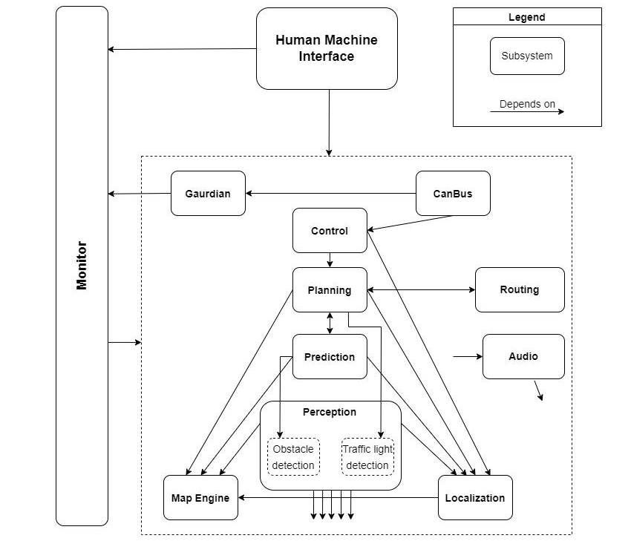
Conceptual Architecture
Figure 1: Conceptual Architecture of Apollo
Implicit Invocation
Using real-time operating system CyberRT with cyber channels as an eventing system to pass data between modules
Each dependency arrow indicates a module is subscribed to an event the preceding module emits.

Slide 8
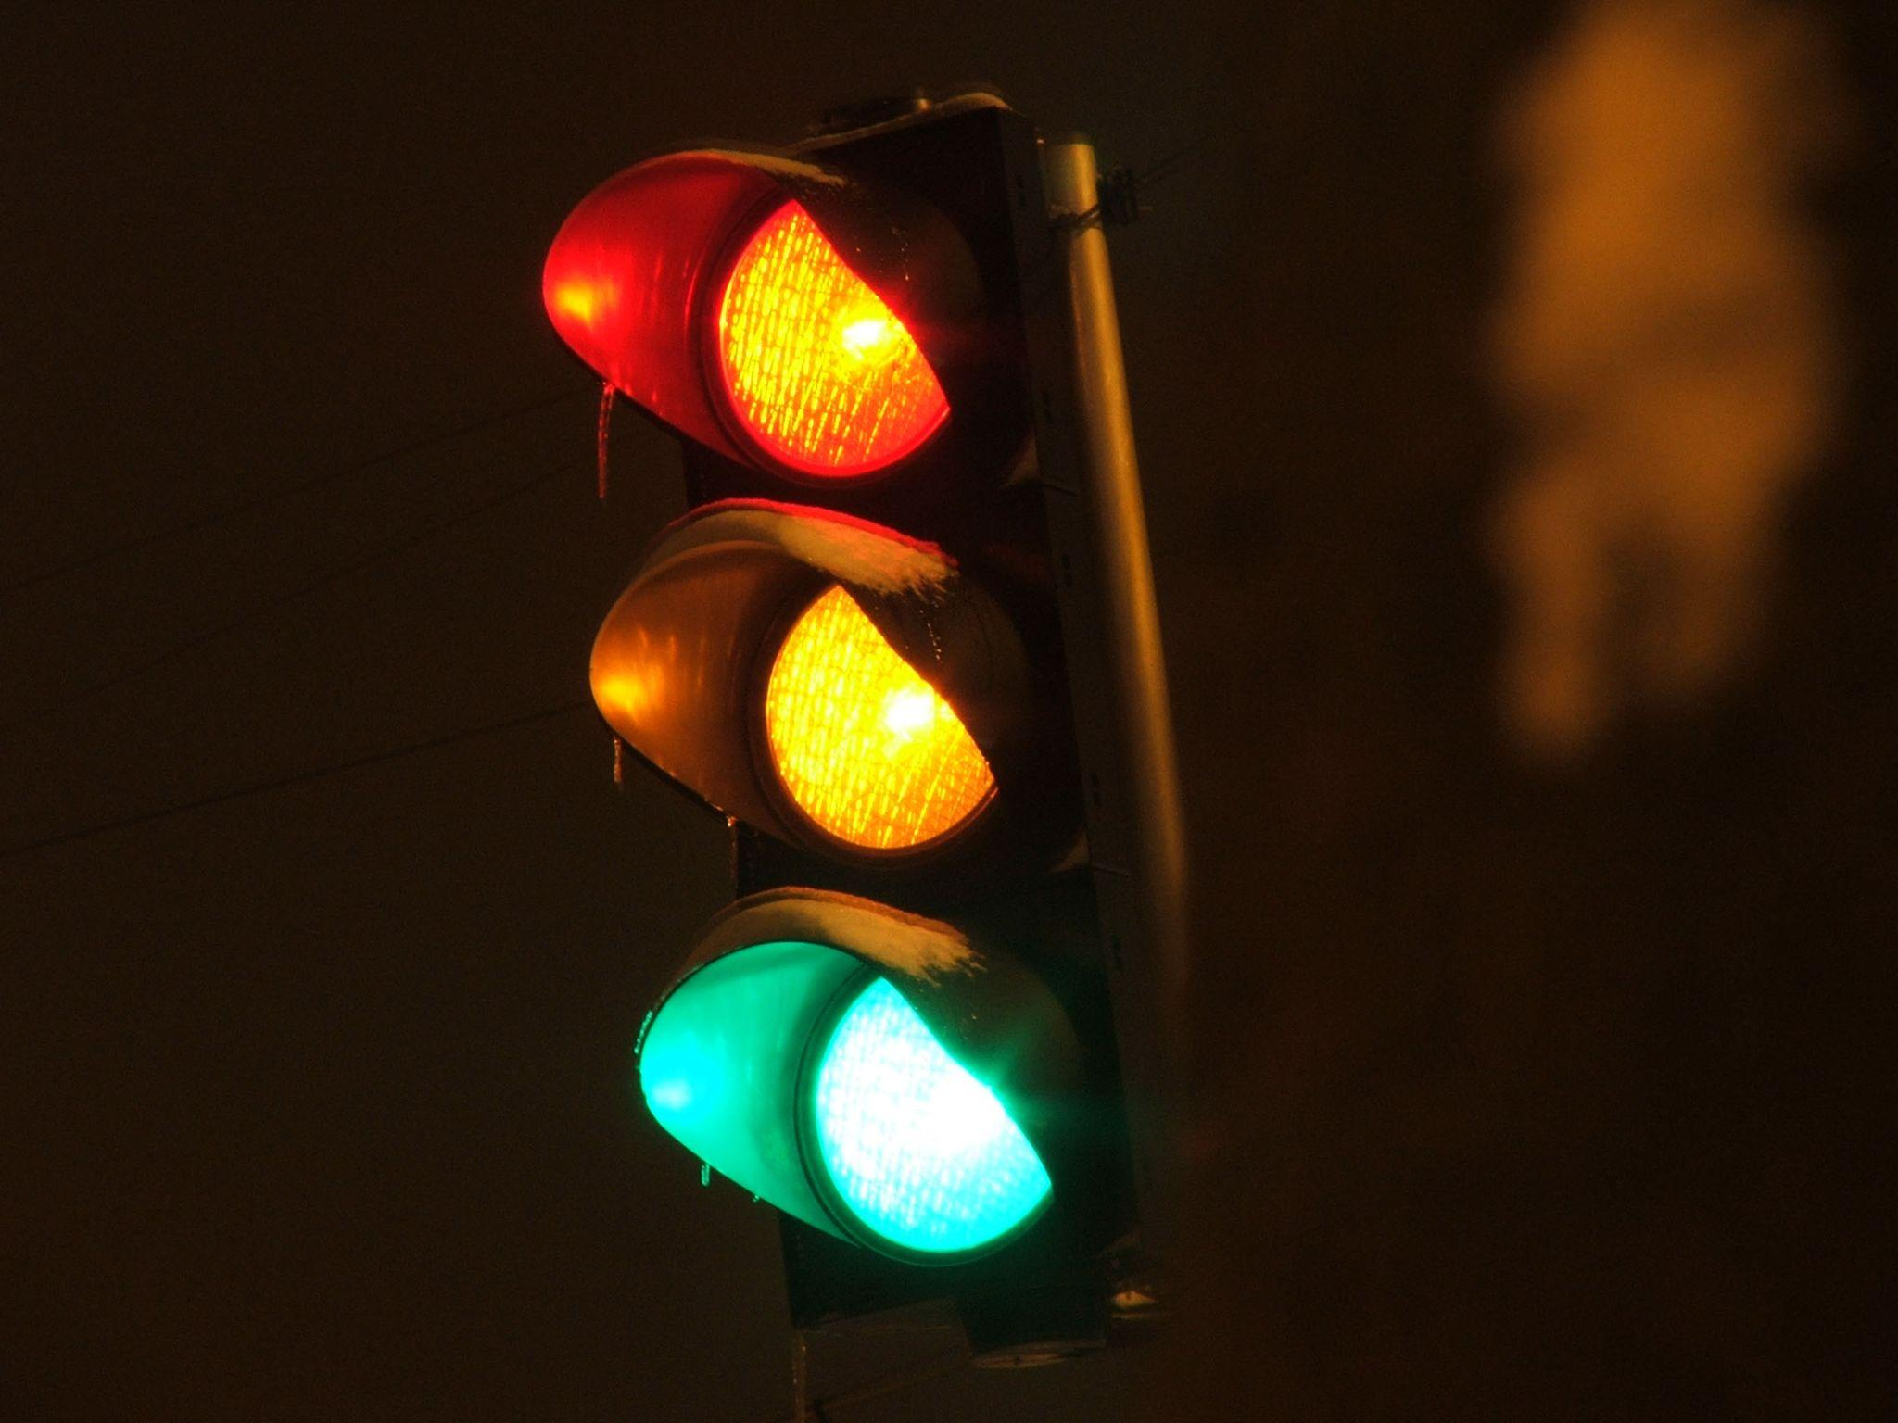
Subsystems
1. Perception
Outputs a 3D obstacle track with the heading, velocity, and classification information for any nearby obstacles or traffic lights recognized by the perception module’s two submodules.
Obstacle Perception Submodule
Detects, classifies, and tracks obstacles in the ROI that is defined by the high-resolution map.
Includes LiDAR and RADAR based obstacle perception
Traffic Light Perception Submodule
Obtains the coordinates of traffic lights in front of the car by querying HD-Map/MapEngine
A larger ROI is created where the traffic lights are detected with a surround bounding box and recognized as different color states.
Notes:
ROI: Region of Interest - area of an image that is selected and deemed as important; the foreground of the image
LiDAR: Light Detection and Ranging
RADAR: Radio Detection And Ranging

Slide 9
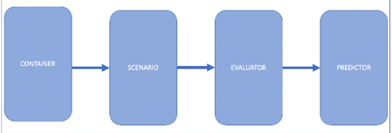
Subsystems
2. Prediction
Studies and predicts behaviors of obstacles detected by the perception module.
3. Planning
Plans a collision-free and safe trajectory for the control module to execute by interacting with other modules.
5. Canbus
Interface that accepts and executes control module commands to the vehicle’s hardware.
6. Human Machine Interface
Provides an interface to enable/disable modules, view hardware status, start the autonomous driving car as well as debugging tools.
4. Control
Manages vehicle control commands (steering, throttle, brake) based on the planned trajectory and the car’s current status.
Notes:
Container -> scenario -> evaluator -> predictor

Slide 10

Subsystems
7. Localization
Aggregates various data to locate the autonomous vehicle and provide localization services. Provides localization using GPS, IMU, and LiDAR information.
10. Audio
Detects siren sounds and displays an active alert on the Dream view web application (HMI) if an emergency vehicle is detected.
11. Routing
Tells the autonomous vehicle how to reach its destination via a series of lanes or roads depending on a topology file.
8. Monitor
Ensures all modules are working and passes its data on to the HMI for the driver to view.
9. Guardian
Intervenes if the Monitor module detects a failure and provides countermeasures
Notes:
GPS: Global Positioning System
IMU: Inertial Measurement Unit
LiDAR: Light Detection and Ranging
HMI: Human-Machine Interface

Slide 11
System Evolution
Apollo release 3.5 is the most important architectural change with the implementation of monitor, and guardian.
Monitor takes input from every component and has guardian interrupt control commands so the CANBus can correct errors and fix failures.

Slide 12
Developer Responsibilities & Data Flow
From observing the software architecture, we can determine there are four major development groups in Apollo.
Perception, Prediction, Planning → Group 1
Control → Group 2
HD Map, Localization, CANBus, Guardian → Group 3
Monitor, HMI → Group 4

Slide 13
Developer Responsibilities & Data Flow
Group 1
Group 1’s main responsibility would be to make the “autonomous” of “autonomous driving car” work.
Perception: ensures radars and cameras are functional
Prediction: ensures A.I understands obstacles
Planning: ensures A.I gives correct instructions to Control

Slide 14
Developer Responsibilities & Data Flow
Group 2
Group 2’s main responsibility would be making sure the Control module is functional.
Control: ensures the instruction (braking, steering, throttling) gets passed to CANBus

Slide 15
Developer Responsibilities & Data Flow
Group 3
Group 3 would be responsible for ensuring the other parts of the group were functional.
HD Map: ensures the map is giving an accurate representation of the road
Localization: ensures the module is giving an accurate prediction of where the car is
CANBus: ensures the module is executing the commands given from Control
Guardian: ensures the module is intervening in cases where Monitor detects a failure

Slide 16
Developer Responsibilities & Data Flow
Group 4
Group 4 would be responsible for monitoring the other groups as well as provide an interface for viewing the status of the vehicle.
Monitor: Ensures the module is monitoring all the other modules as well as feeding Guardian with adequate information
HMI: Maintains the interface to ensure that it is providing the correct statuses of the vehicle

Slide 17
Concurrency
Most of the system is very concurrent. A few specific examples of concurrency within Apollo are:
The monitor module, which runs concurrent to all other software to monitor the system’s health
The camera systems that all have drivers running concurrently to everything else in the system to provide a continuous input field.
The HMI (human-machine interface), which is a web server that is run beside the rest of the system, providing a visual of what the autonomous car is doing.

Slide 18
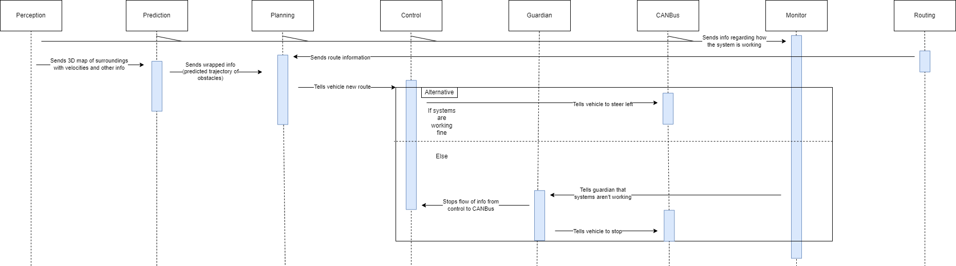
Sequence Diagram
Use case when the car is driving and the road twists left

Slide 19
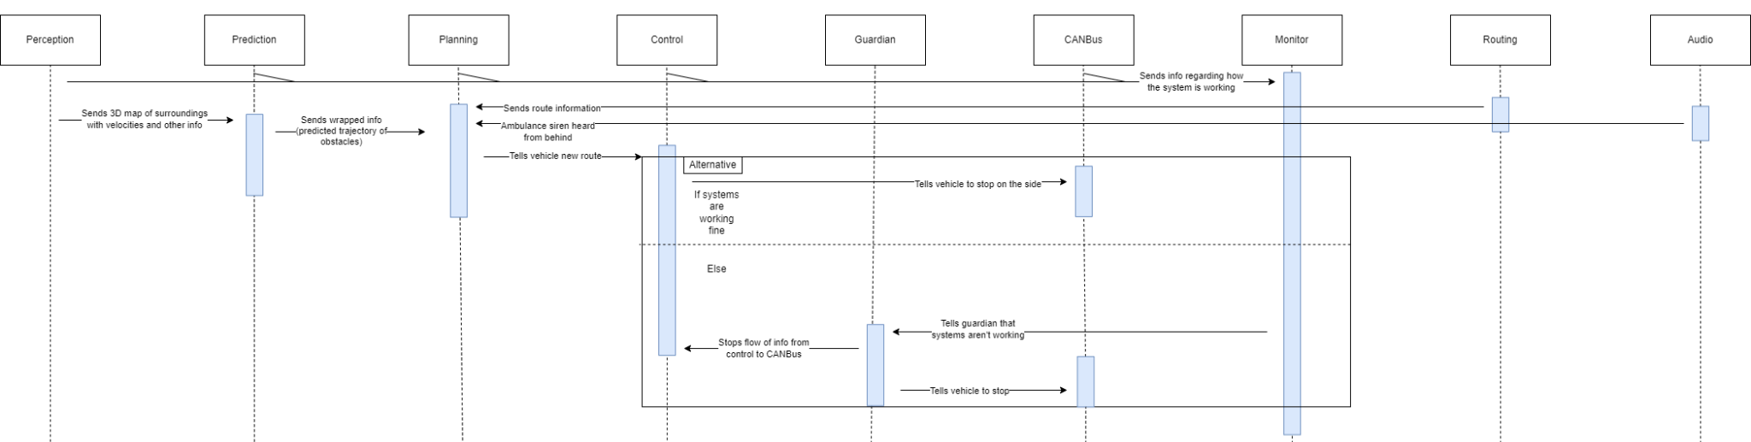
Sequence Diagram
Use case when an ambulance is heard

Slide 20
Limitations and Lessons Learned
Some limitations of the architecture being used are the sub-optimal calling of procedures that a broadcasting system may cause. This system has a lot of data being transferred from cameras, microphones, and other peripherals, and a pipe-and-filter architecture might be able to streamline this aspect of the software better.
We learnt a lot about the process of discovering the conceptual architecture of a system through the documentation. Learning how to read and interpret the documents, and finding different resources from the repository, website, and research papers.

Slide 21
Conclusion
The Apollo autonomous driving system uses a specialized implicit invocation architecture and the control component uses a process-control architecture.
Implicit invocation is an event handling architecture essential for automated driving as the vehicle needs fast scenario based decision making to match the systems environment.
Process-control architecture is also critical as the vehicle controls are always changing so the vehicle can reach its target destination while maintaining its target speed and safety protocols.

